Slide 1
Paper Presentation
“Retrieval-based Neural Source Code Summarization”
Presented by
Md Mynuddin
ID : ASH1825007M
Mahbub Alam
ID : ASH1825003M
NSTU, IIT
Published on
“International
Conference on Software Engineering”
Seoul, Republic of Korea
Accepted: 23-29 May 2020

Slide 2
Introduction
Source code summarization is the process of generating concise descriptions of source code, often in the form of code comments.
This is important for understanding and maintaining source code, as developers often spend a lot of time reading and comprehending programs without good software documentation.
There have some automatic source code summarization techniques
Information Retrieval(IR) for Term-based summaries
Neural Machine Translation(NMT) for generate summaries word-by-word from code snippets

Slide 3

Problem
NMT-based approaches have difficulty in handling low-frequency words.
It may result in incorrect summaries.

Slide 4
Solution
The authors proposes a solution called Retrieval-based Neural Source Code Summarizer (Rencos)
They conducted extensive experiments on two real-world datasets and performed a human evaluation through Amazon Mechanical Turk (AMT) to evaluate their proposed approach.
It combines the advantages of both NMT-based and retrieval-based methods for source code summarization.
The proposed architecture first trains an attentional encoder-decoder model to obtain an encoder for all code samples and a decoder for generating natural language summaries.

Slide 5
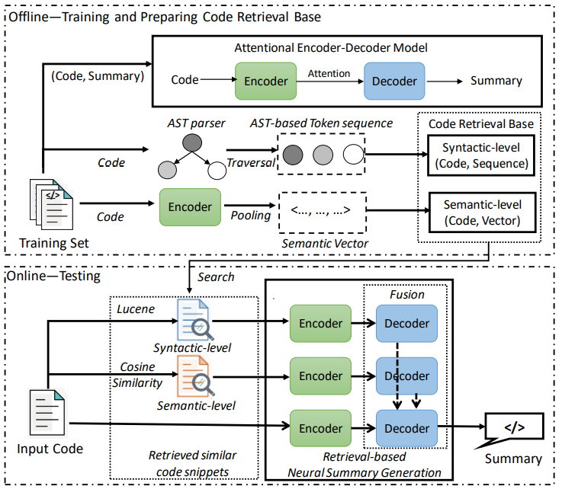
Solution (Continue…)
The Figure shows the overall framework of the solution

Slide 6
Solution
Then, given an input source code snippet, it retrieves the most similar code snippets from the training set based on both syntax-level and semantics-level information.
These retrieved code snippets are used as context vectors and their similarity values are used to adjust the conditional probability of the next word during decoding. This helps to enhance the prediction results of the NMT model.

Slide 7
Experiments
They conduct experiment to evaluate the effectiveness of the proposed approach.
Compare it with several state of the art methods from Software Engineering (SE) .
And Natural Language Processing (NLP) communities.

Slide 8
Experimental Setup
Two public large-scale datasets :
PCSD(Python Code Summarization Dataset) : Provided by Barone
Contains Python Function and Comment
This dataset includes 108,726 code-comment pairs.
Used for training and evaluation
JCSD(Java Code Summarization Dataset) : Collected by Hu
Contains Java methods and comments.
This dataset includes 69,708 code and comment pairs.
Used for training and evaluation

Slide 9

Evaluation Metrics
They evaluate the performance of different approaches using common metrics including:
BLEU
METEOR
ROUGE-L
CIDER

Slide 10

Baseline Methods
Retrieval-based approaches :
LSI
VSM
NNGen
NMT-based approaches :
CODE-NN
TL-CodeSum
Hybrid-DRL

Slide 11
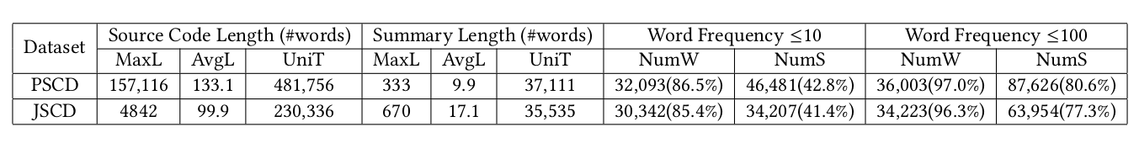
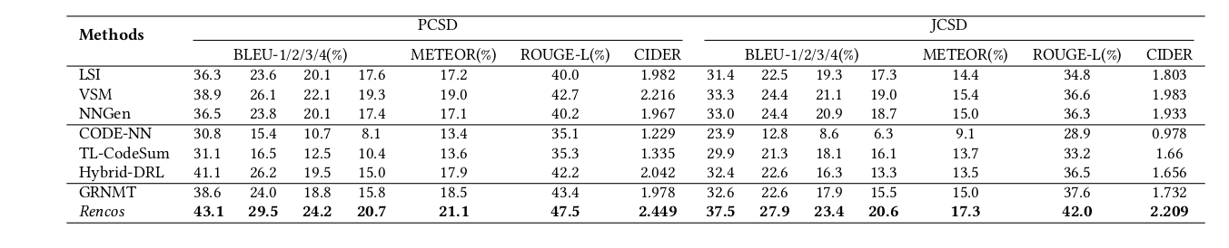
Result
The statistics of two datasets
Method comparison for source code summarization

Slide 12
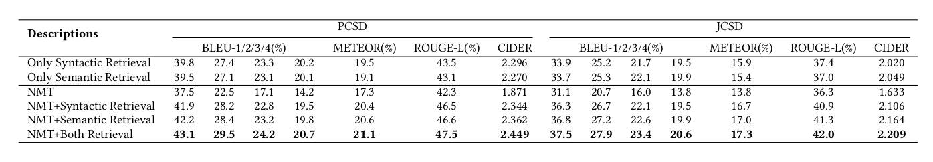
Continue..
Effectiveness of each component of the proposed approach

Slide 13
Related Works
Information Retrieval techniques are widely used for automatic source code summarization.
Haiduc use IR methods including LSI and VSM to choose top-k terms from a code snippet.
Rodeghero et al. improve the process of selecting terms by eye-tracking and modify the weights of VSM for better code summarization
Sridhara et al. [52] design Software Word Usage Model (SWUM) to identify keywords from those statements and create summaries though manually-crafted templates.

Slide 14

Limitation
Proposed approach only for Python and Java code - comment dataset.
when the code base is small proposed approach is not work well.
For the low frequency of words need more large scale dataset.

Slide 15

Future Work
Experiment with even larger-scale datasets.
Evaluate the effectiveness of “Rencos” in handling low-frequency words.
Notes:
Retrieval-based Neural Source Code Summarizer

Slide 16
Interesting Part
Their experimental data and results are publicly available
https://github.com/zhangj111/rencos
https://github.com/xing-
https://github.com/OpenNMT/OpenNMT-
https://github.com/sriniiyer/codenn
https://github.com/wanyao1992/code_summarization_public

Slide 17
Conclusion
They propose a novel retrieval-based neural approach named “Rencos”
Used an attentional encoder-decoder model to find the two most comparable code snippets for enhanced source code summary.
To accommodate more information about the code, they also develop two code retrieval methods from the perspectives of syntax and semantics.
Syntactic level (Lucene) and Semantic level (Cosine similarity).
And finally evaluated the effectiveness of their approach.
Notes:
The encoder-decoder model is a way of organizing recurrent neural networks for sequence-to-sequence prediction problems or challenging sequence-based inputs like texts [ sequence of words ]

Slide 18


